Slide 1
Administrative concertation
(Brussels, 4 October 2017)
Draft delegated act adjusting the contributions to the unemployment scheme for former members of the temporary or contract staff and accredited parliamentary assistants who are unemployed after the termination of their service in an EU institution

Slide 2
Delegated acts under the SR /
Social dialogue aspect
Second Delegated act under Staff Regulations to be adopted by the Commission – careful approach following the successful experience from the first exercise
Full Respect of the Framework Agreement between the Commission and its OSPs
Information to the staff representatives from the other EU institutions
Information to administrations of the other institutions (CPQS)

Slide 3
General features of the Unemployment Fund
Defined Benefit Obligation Fund:
  common for all Institutions
  managed by the Commission (PMO)
The scheme is fully funded (special fund outside the budget)
  0.81 % of the basic salary, minus deduction of a standard allowance (employee)
  The remaining 2/3 are borne by the institution (employer)
Total contributions amounted to approx. € 21.6 million in 2015
The Commission may, by means of delegated act, adjust the contributions, if this is necessary in the interests of the balance of the scheme

Slide 4
Historical background of the Fund
Before 2004 – only Temporary Agents (TAs) were eligible for unemployment benefits. They paid 0.4 % contribution and 0.8 % was paid by the employer
2004 Reform of the Staff Regulations – Contract Agents (CAs) included in the scheme. Contributions are raised to 0,81% for staff and 1,62% for the employer
Council Regulation No 160/2009 – Accredited Parliamentary Assistants (APAs) included in the scheme
2013 Reform of the Staff Regulations – the maximum duration of contracts of CAs(3b) set to 6 instead of 3 years

Slide 5
Eligibility for unemployment benefits
Material conditions
Paid contribution to the fund as AT/CA/APA;
Unemployment not due to resignation/disciplinary sanction;
Worked for at least 6 months;
Resident of a MS of the EU.
Procedural conditions
Registered with the unemployment authorities of a MS;
Meets the condition for unemployment benefits of that MS;
Certifies before the Commission the unemployment status (monthly).

Slide 6
The unemployment benefit
As a % of the basic salary:
1st year - 60%
2nd year - 45%
3rd year - 30%
Family allowances
JSIS cover
No longer than 1/3 of the actual length of service
Upper and lower limits apply
National benefits are deducted
Subject to the EU tax
No correction coefficient
 | TA | CA | APA
Maximum (as from the 7th month) | 2 851.59 | 2 138.67 | 2 213.62
Minimum | 1 425.79 | 1 069.34 | 940.79

Slide 7
Source: 2016 Report, p. 10

Slide 8
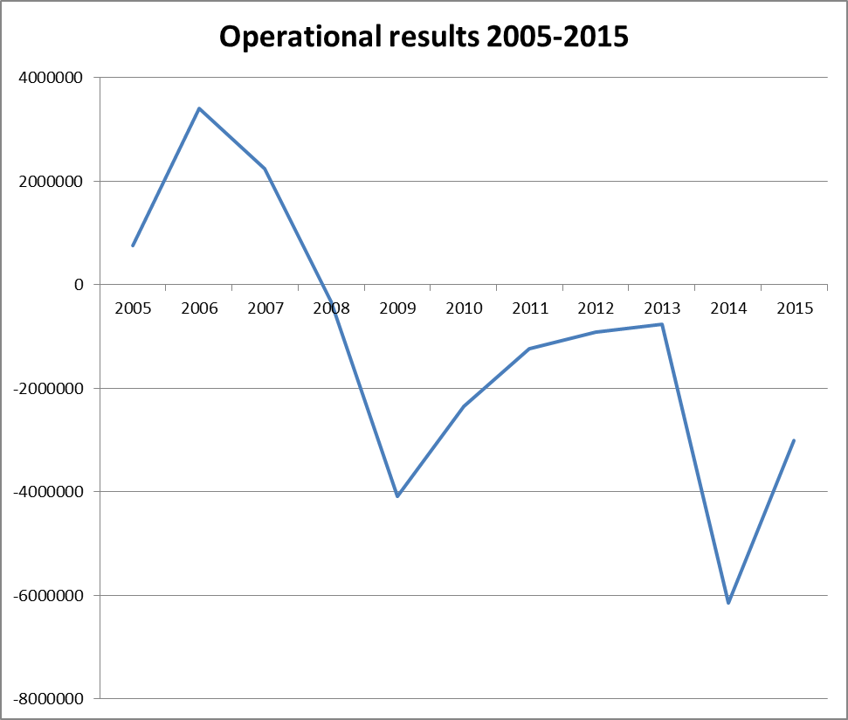
Source: 2016 Report, p. 9

Slide 9
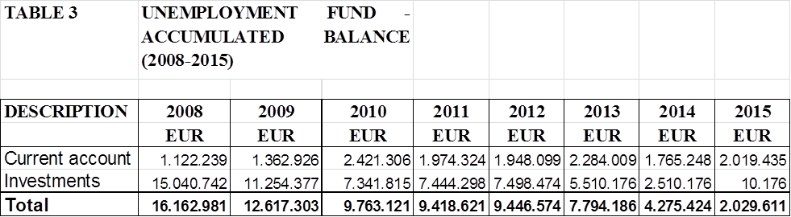
FINANCIAL POSITION AND CASH BALANCE OF THE FUND
Source: Report, p. 7

Slide 10
Main conclusions of the Commission Report (2016) 754
The substantial out-flows decreased all available reserve (2mil€ at the end of 2015 as compared to 16mil€ in 2008);
Trends suggested that the reserves may not be sufficient to cope with the expected increase of expenses in 2017-2018 (end date of many contracts) and more substantially in 2019 (EP elections);
"The Commission is considering, as a first step, a limited increase (around 0.1 % of basic salary, taking specific account of the accumulated balance of the Fund during the period examined in this Report)"

Slide 11
Follow-up on the report
The Commission keeps on closely monitoring the evolution of the financial balance of the Fund which recently has been positive (the latest – unofficial and unpublished – estimate of the accumulated reserve is currently €17 million)
The Commission convened an ad hoc expert group with the Member States and the EP (01/03/2017) to explore the limited increase of the rate (of around 0.1% of the basic salary) in order to be able to meet the challenges ahead
Member States supported an increase of the contribution rate and even suggested increasing by 0.2% in order to secure reserves for future needs
The GTR was consulted (27/04/2017)

Slide 12
Adoption of a Delegated Act (informal stage)
The adjustment of the contribution rate involves an assessment of complex economic and human resources policy factors, in which the legislator enjoys a wide margin of discretion
The Commission has the delegated power to adjust this rate, if this is necessary in the interests of the balance of the scheme
The Inter-Institutional Agreement on Better Law-making requires that Member States' experts are consulted in a timely manner on each draft delegated act prepared by the Commission services
The preparation and drawing-up of delegated acts may include consultations with stakeholders

Slide 13
What's next?
2nd Informal Consultation with the MS and EP (27/10/17)
Staff Regulations Committee (for the avoidance of any legal doubt)
Adoption of the Delegated Regulation by the College
Once adopted, the delegated act is notified to the co-legislator
The delegated act enters into force if no objection has been expressed by the EP or the Council within two months or before, if they inform the Commission that they will not object

Slide 14
Consequences on colleagues' payslips
The monthly contribution of concerned colleagues will increase, from € 1 (contract agent FG I) to € 20 (temporary agent AD16)
In exchange, twice that amount will be paid out from the general budget to the Unemployment fund, thereby ensuring the sustainability of the scheme while maintaining the same level of benefits

Slide 15

Thank you for your attention!
European Commission
Brussels, 2017

